Slide 1
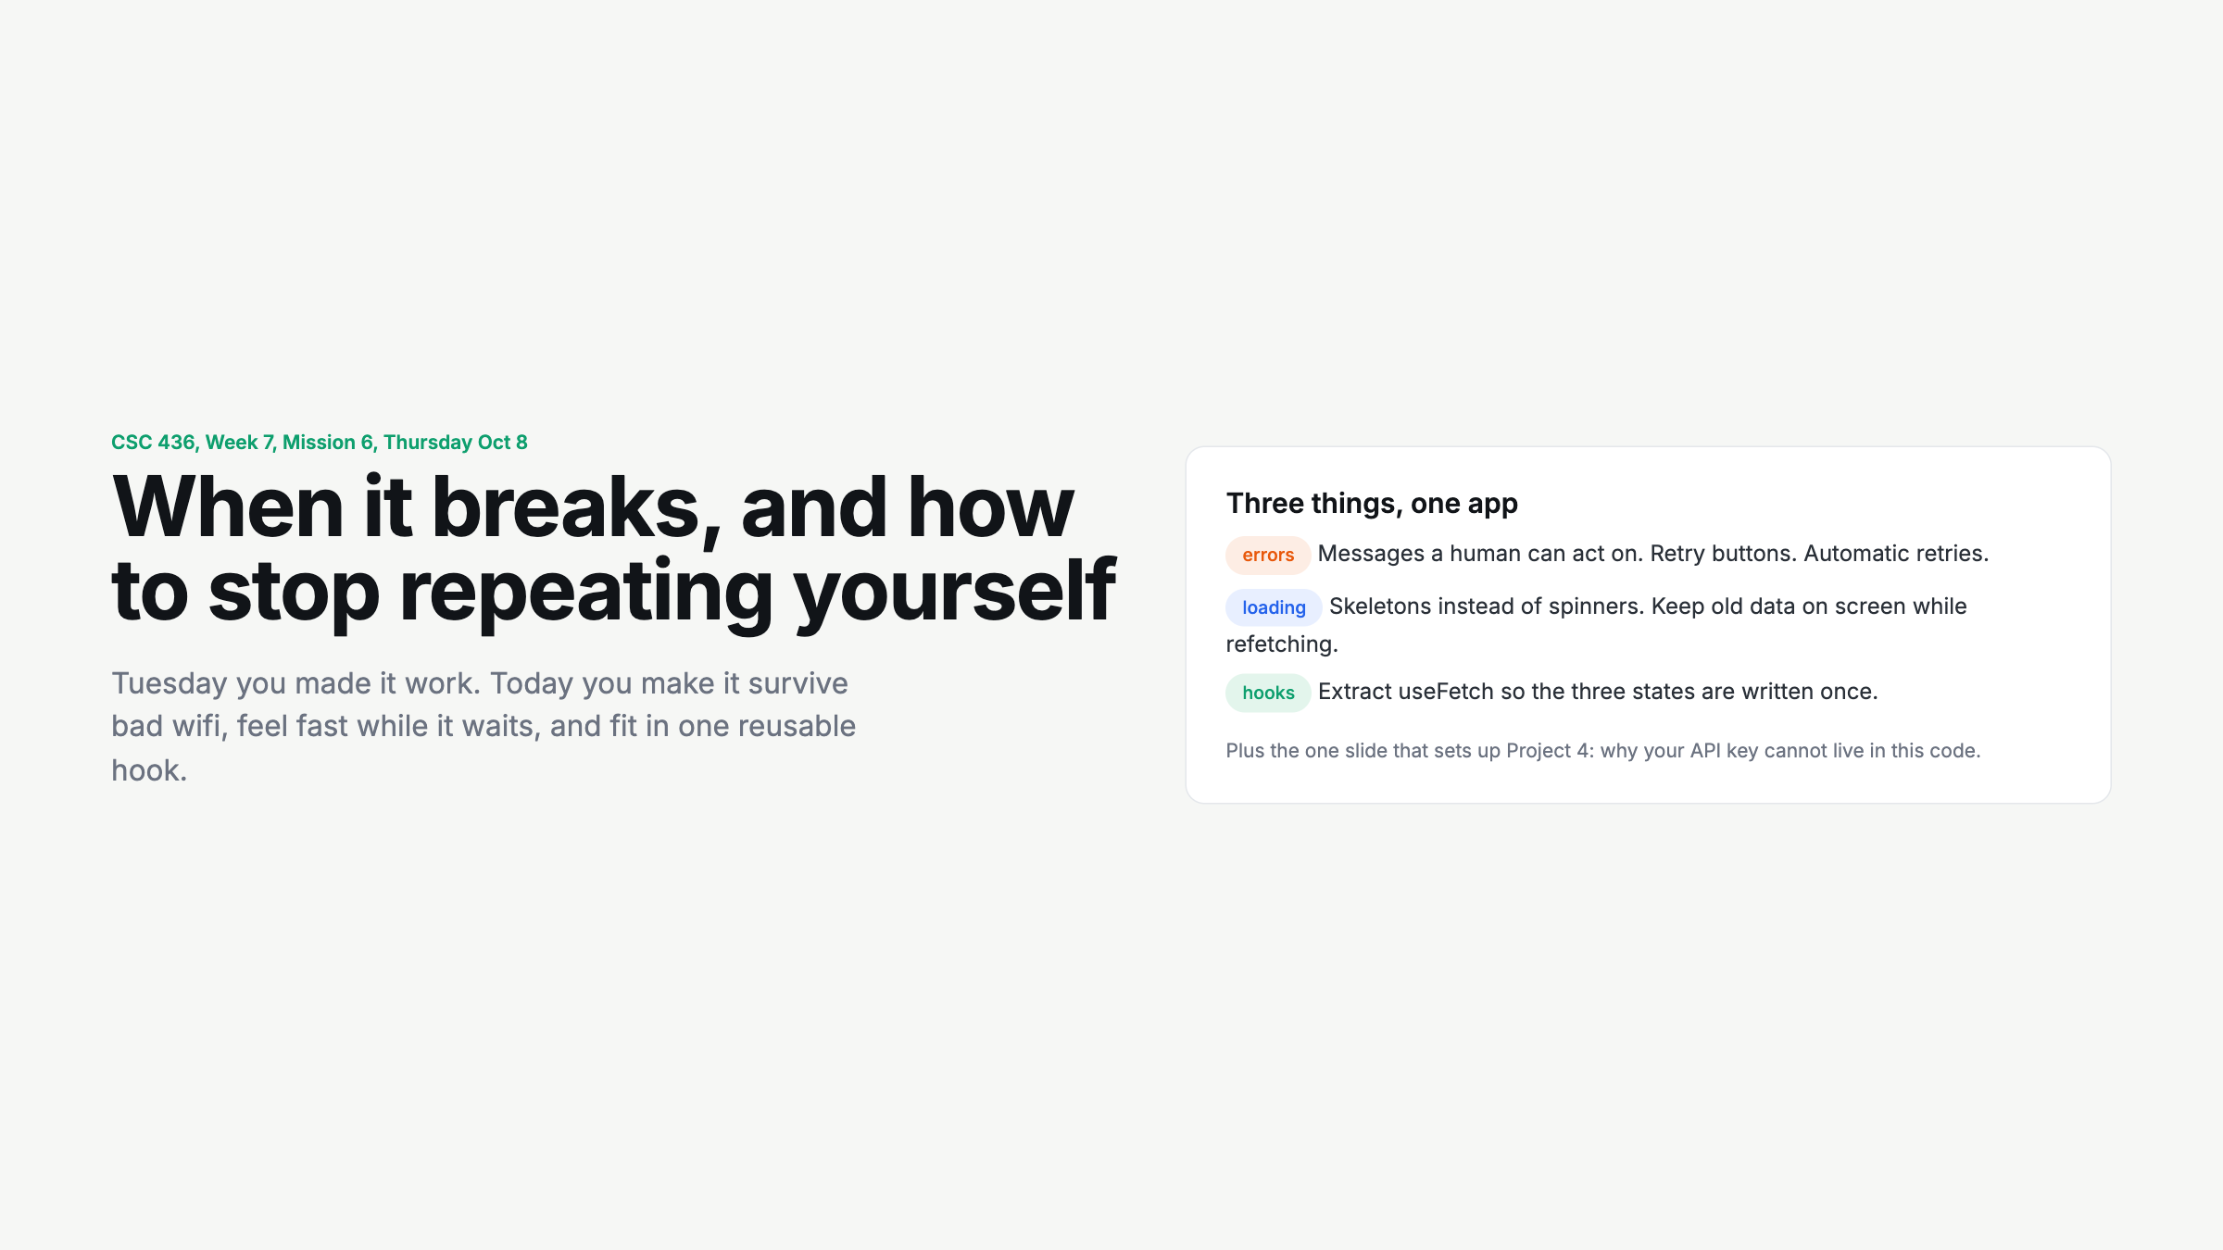
Notes:
Quick. Three chips, three segments. Say: Tuesday it worked, today it survives.

Slide 2
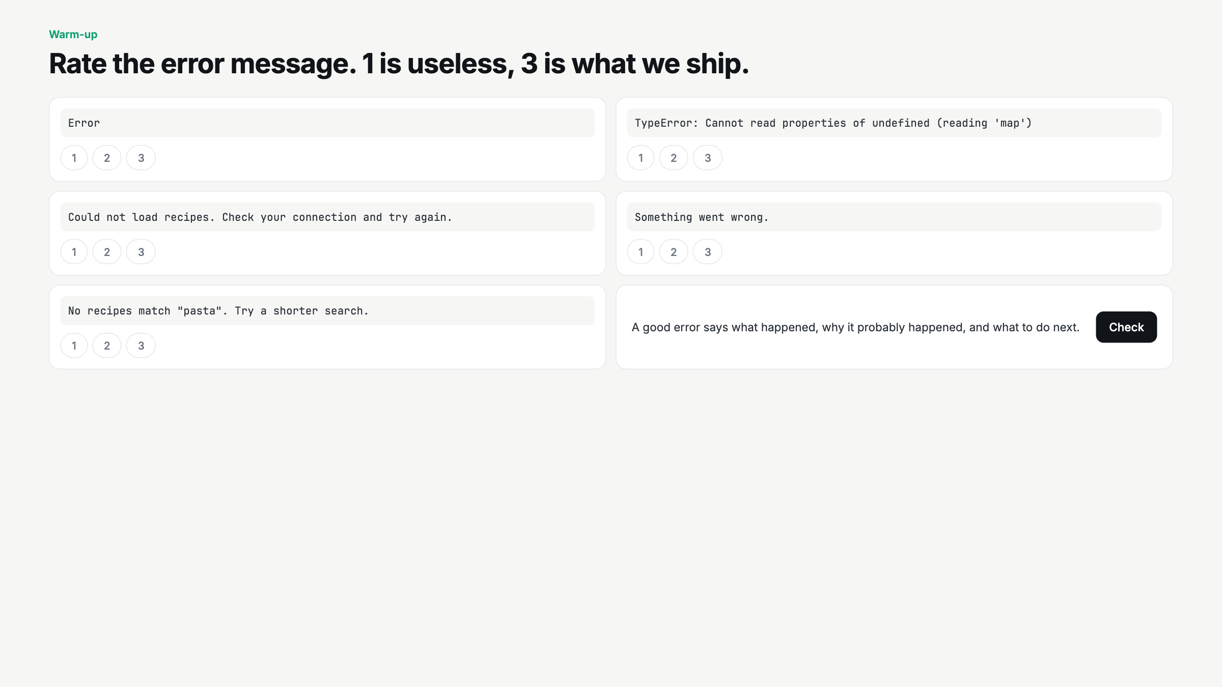
Notes:
Vote by hand per message. The raw TypeError one gets laughs. The empty-state one is the trick: not an error, and it scores a 3. Land the rule: what happened, why, what next.

Slide 3
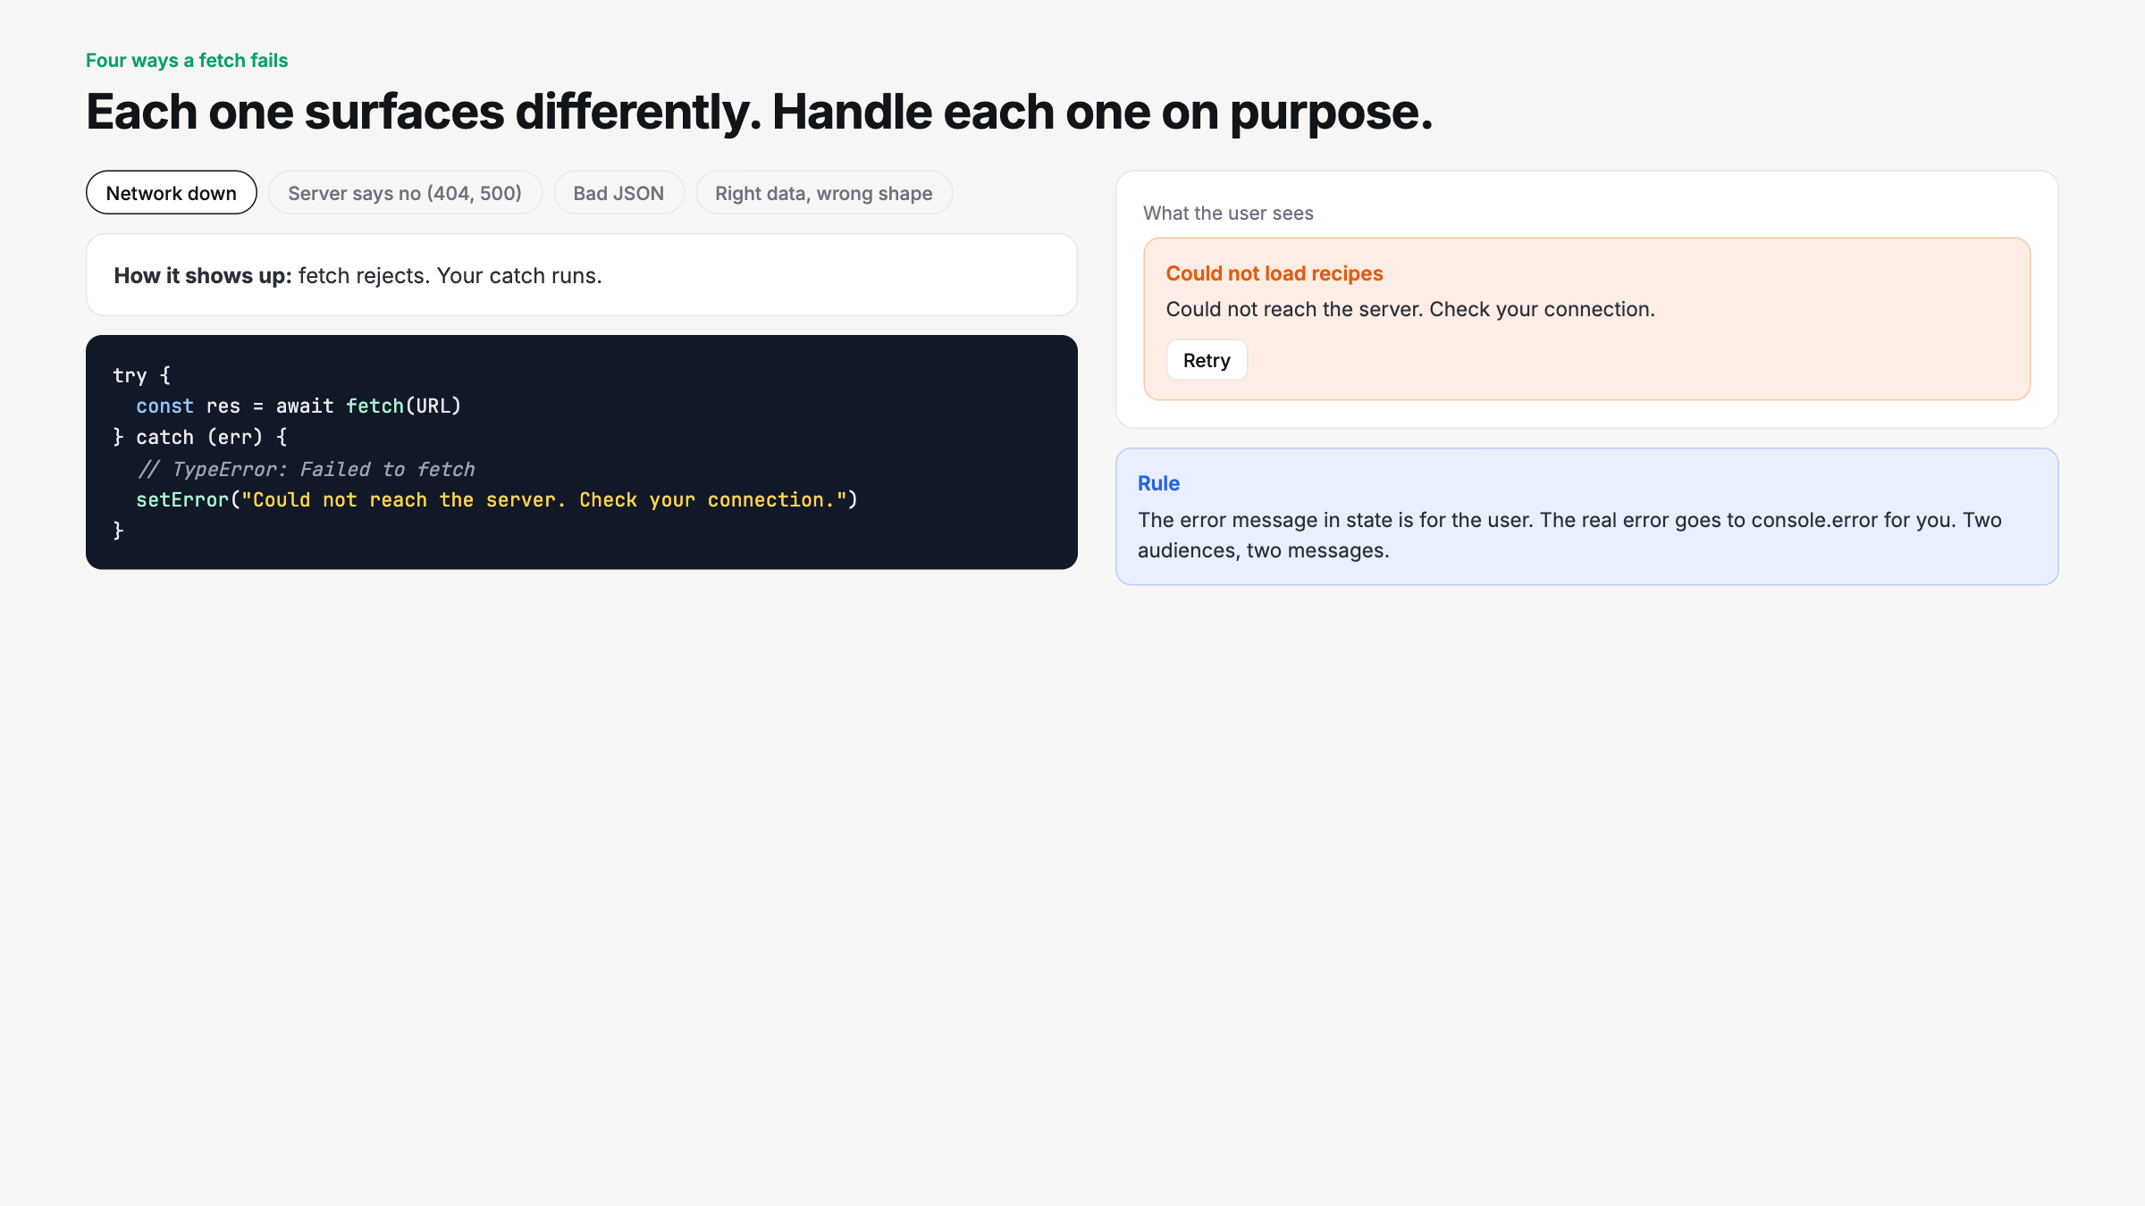
Notes:
Click through all four. Spend the longest on 'right data, wrong shape' since it never hits catch. Two audiences, two messages: user gets state, you get console.error.

Slide 4
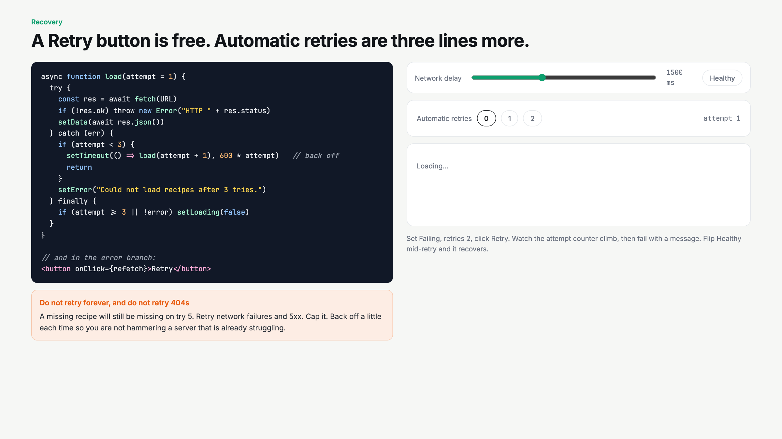
Notes:
Set Failing, retries 2, Retry. Watch attempt climb to 3 then fail. Flip Healthy while it is retrying and it recovers. Ask: should a 404 retry? No.

Slide 5
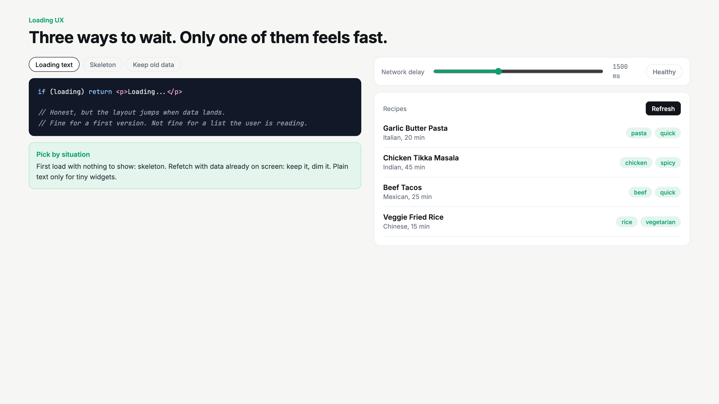
Notes:
Set delay 2500. Click Refresh in each mode. Text jumps, skeleton holds shape, stale keeps the list. Ask which one they would want in their phone's food app.

Slide 6
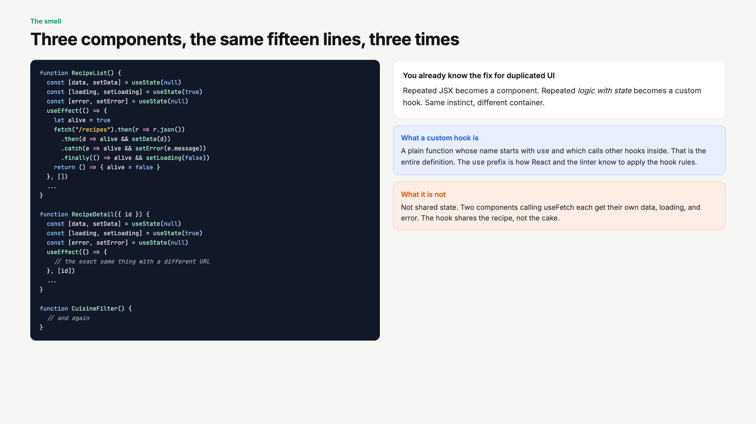
Notes:
Let them groan at the code. Ask what they did last week when JSX repeated: made a component. Same instinct. Define custom hook in one sentence.

Slide 7
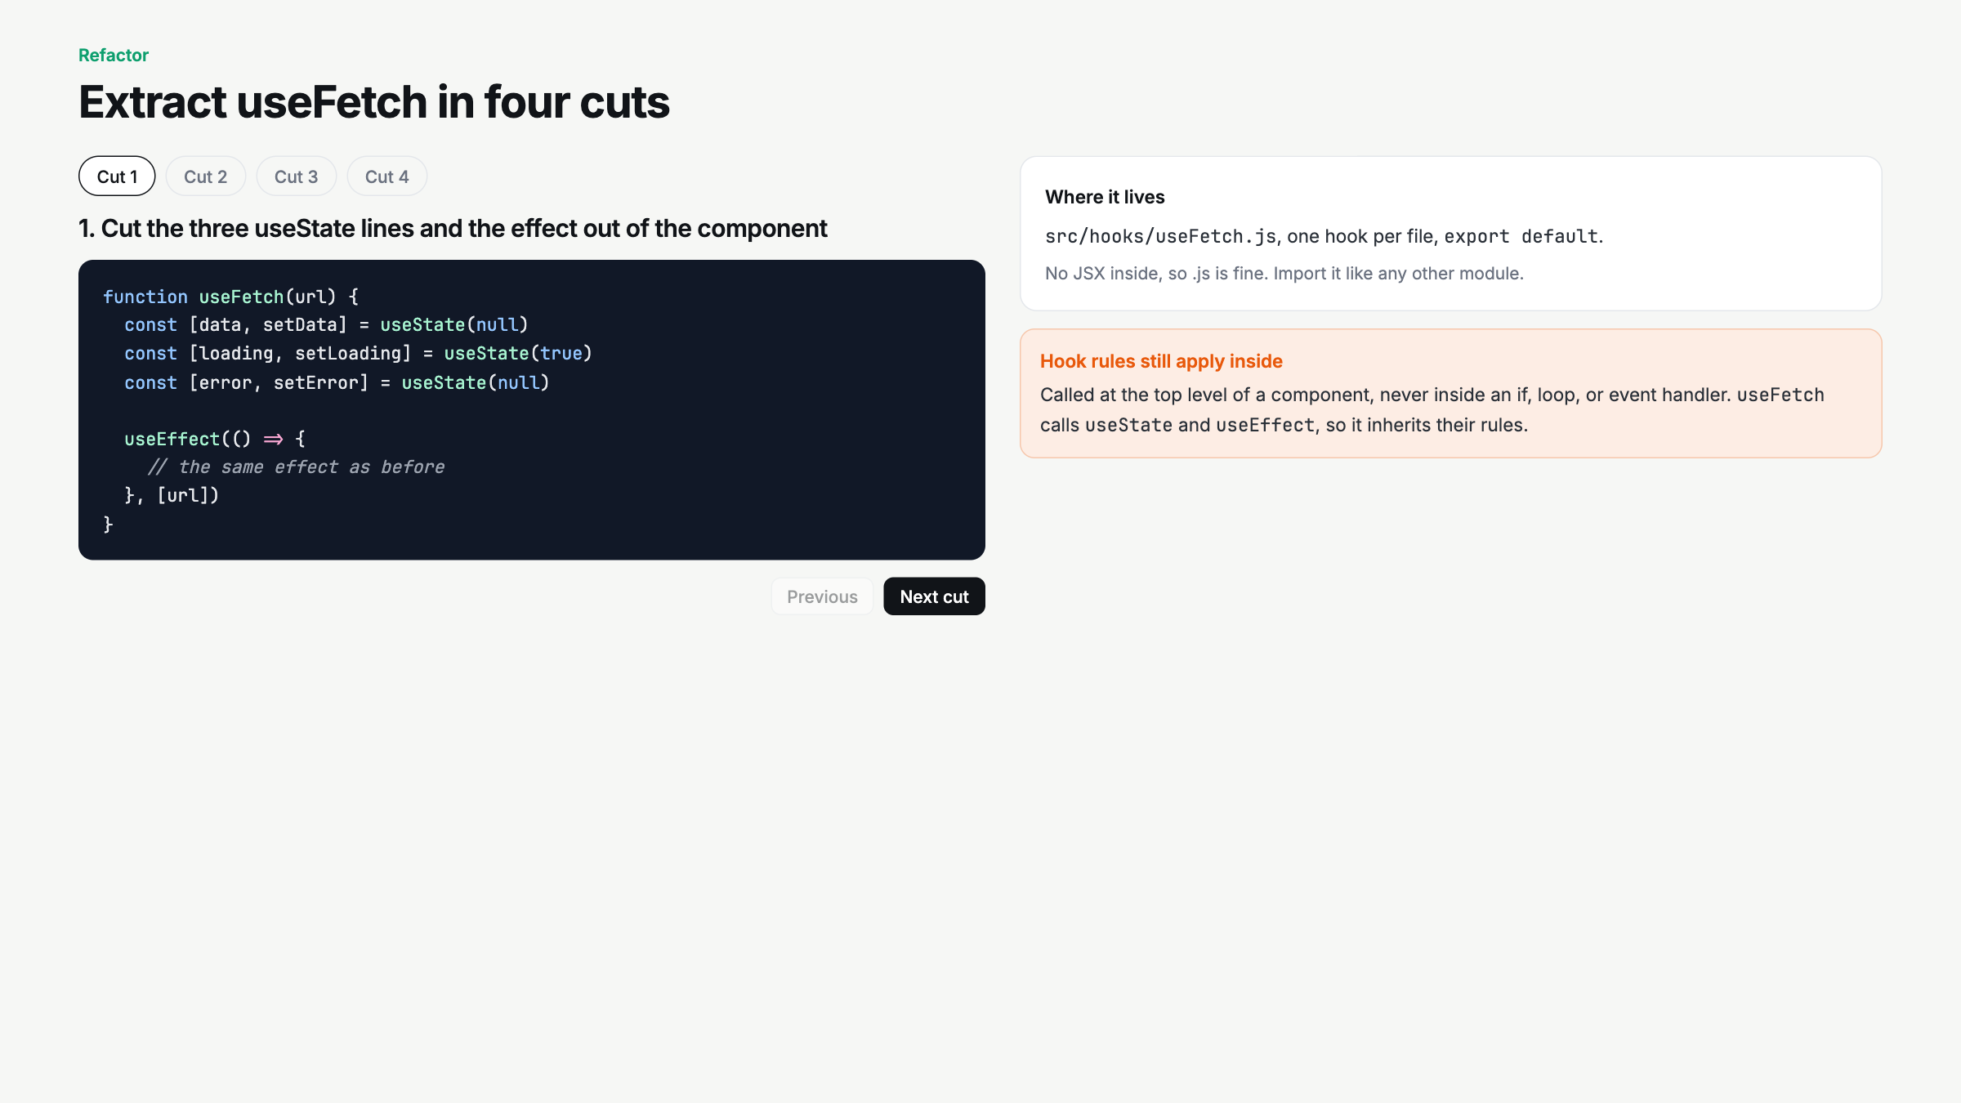
Notes:
Live-code this in examples/recipe-finder, Stage6.jsx into hooks/useFetch.js. Four cuts, in order. Do not skip cut 2, the url parameter is the whole point.

Slide 8
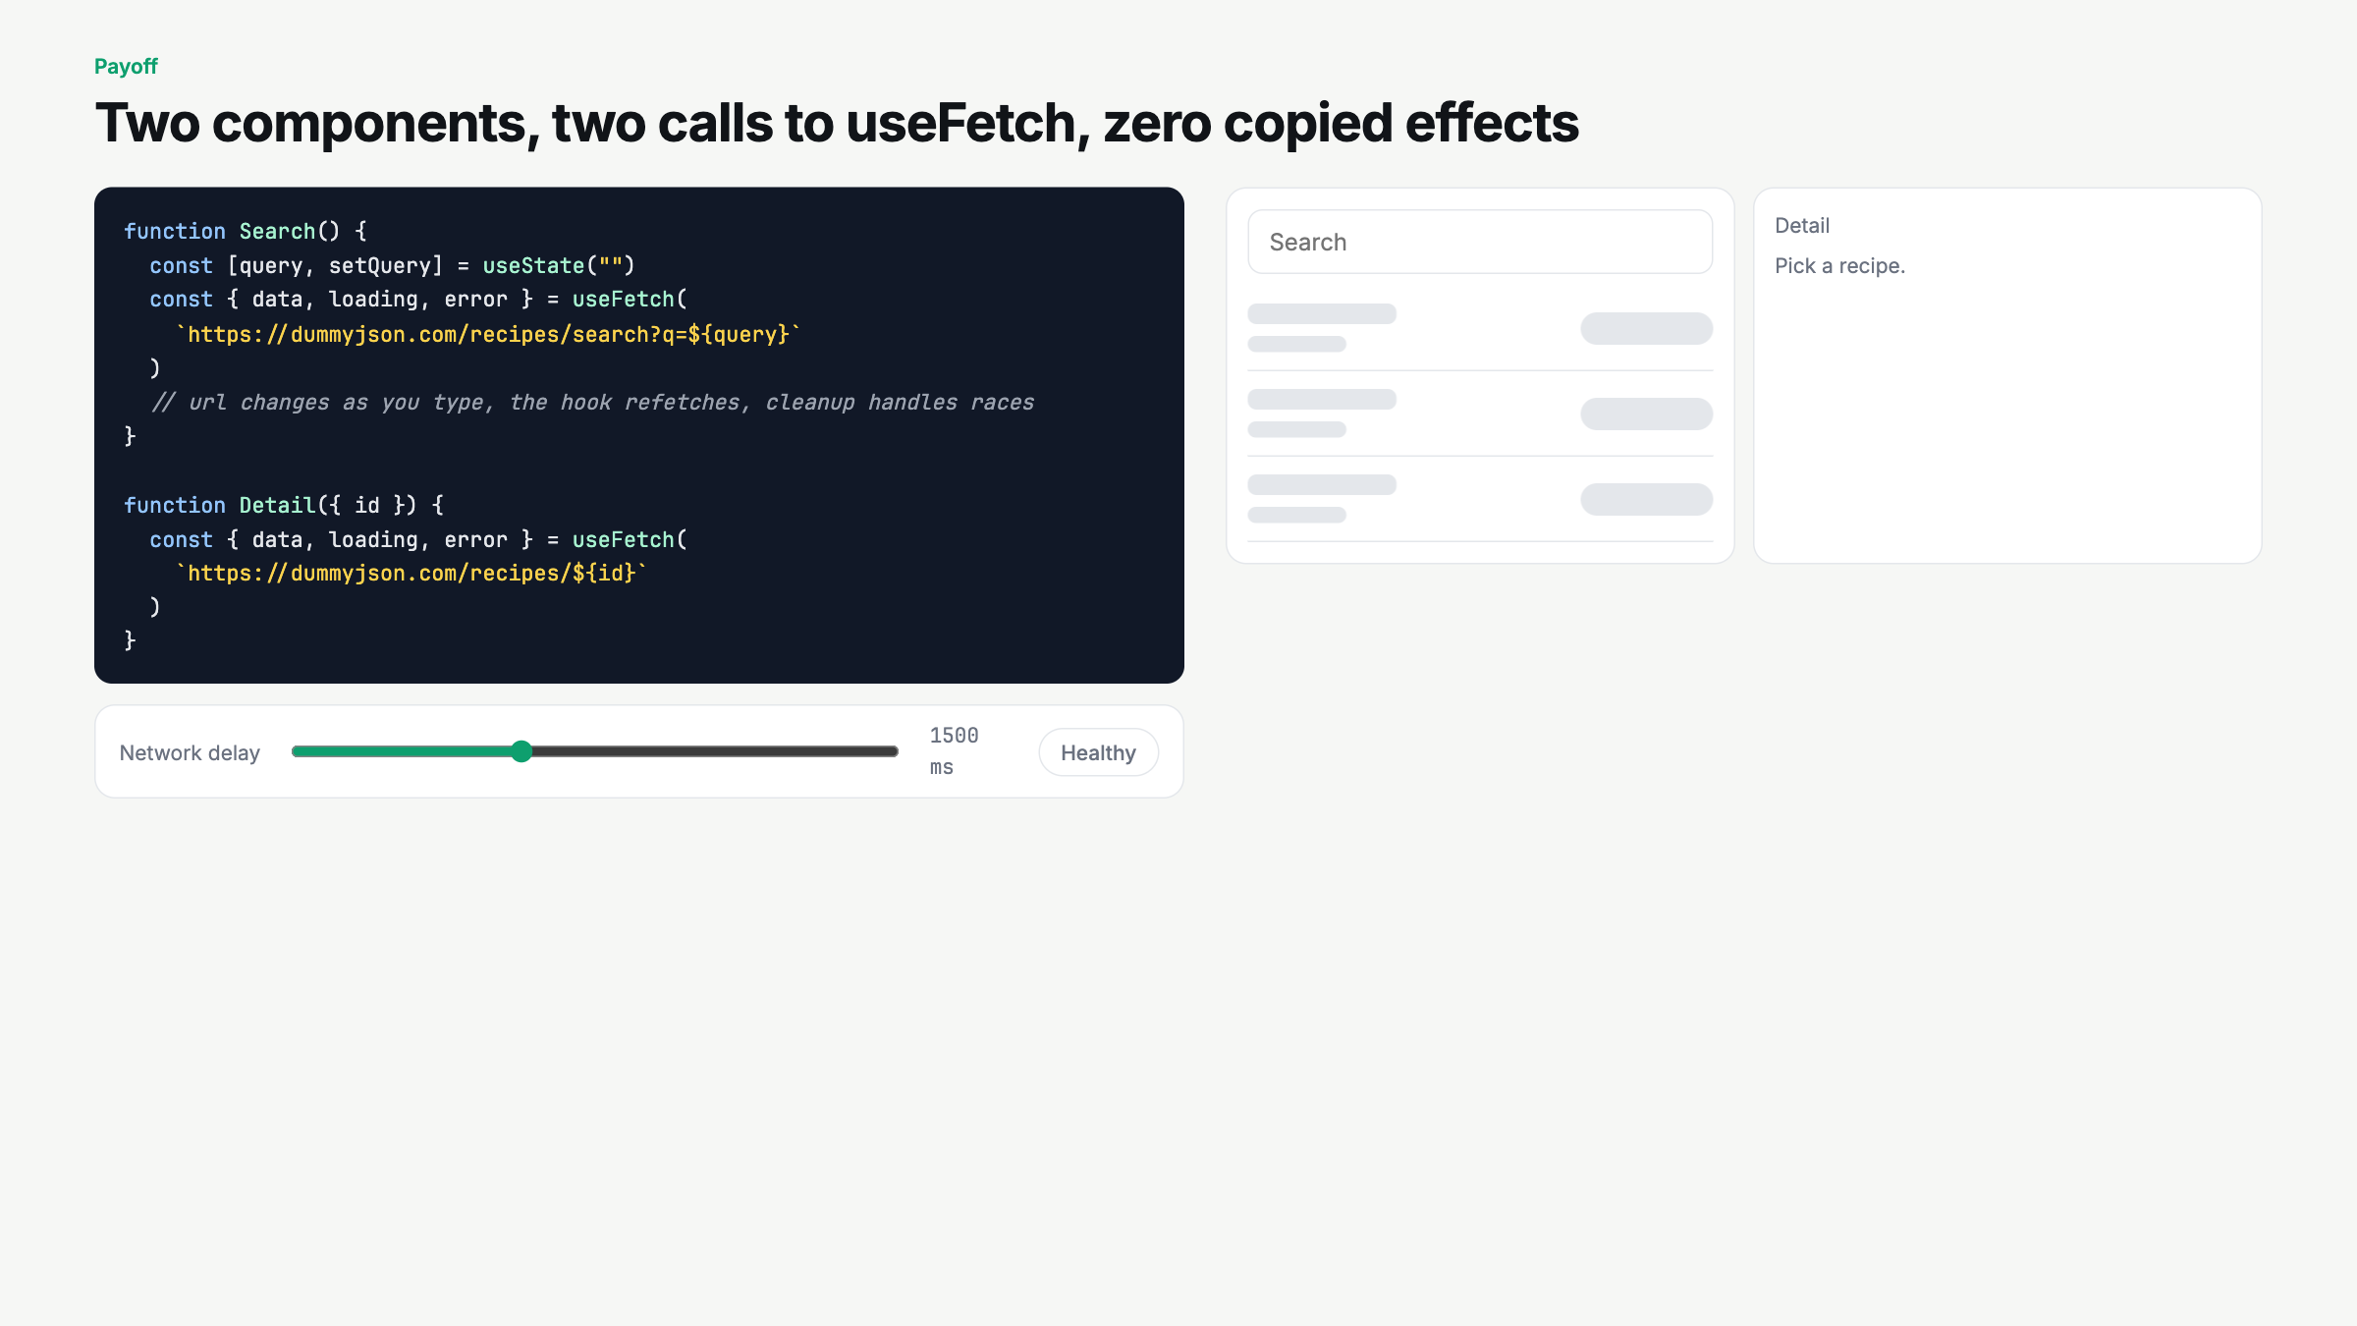
Notes:
Type, pick a recipe, set Failing, hit retry. Two useFetch calls, independent states. Ask: do they share data? No. Shares the recipe, not the cake.

Slide 9
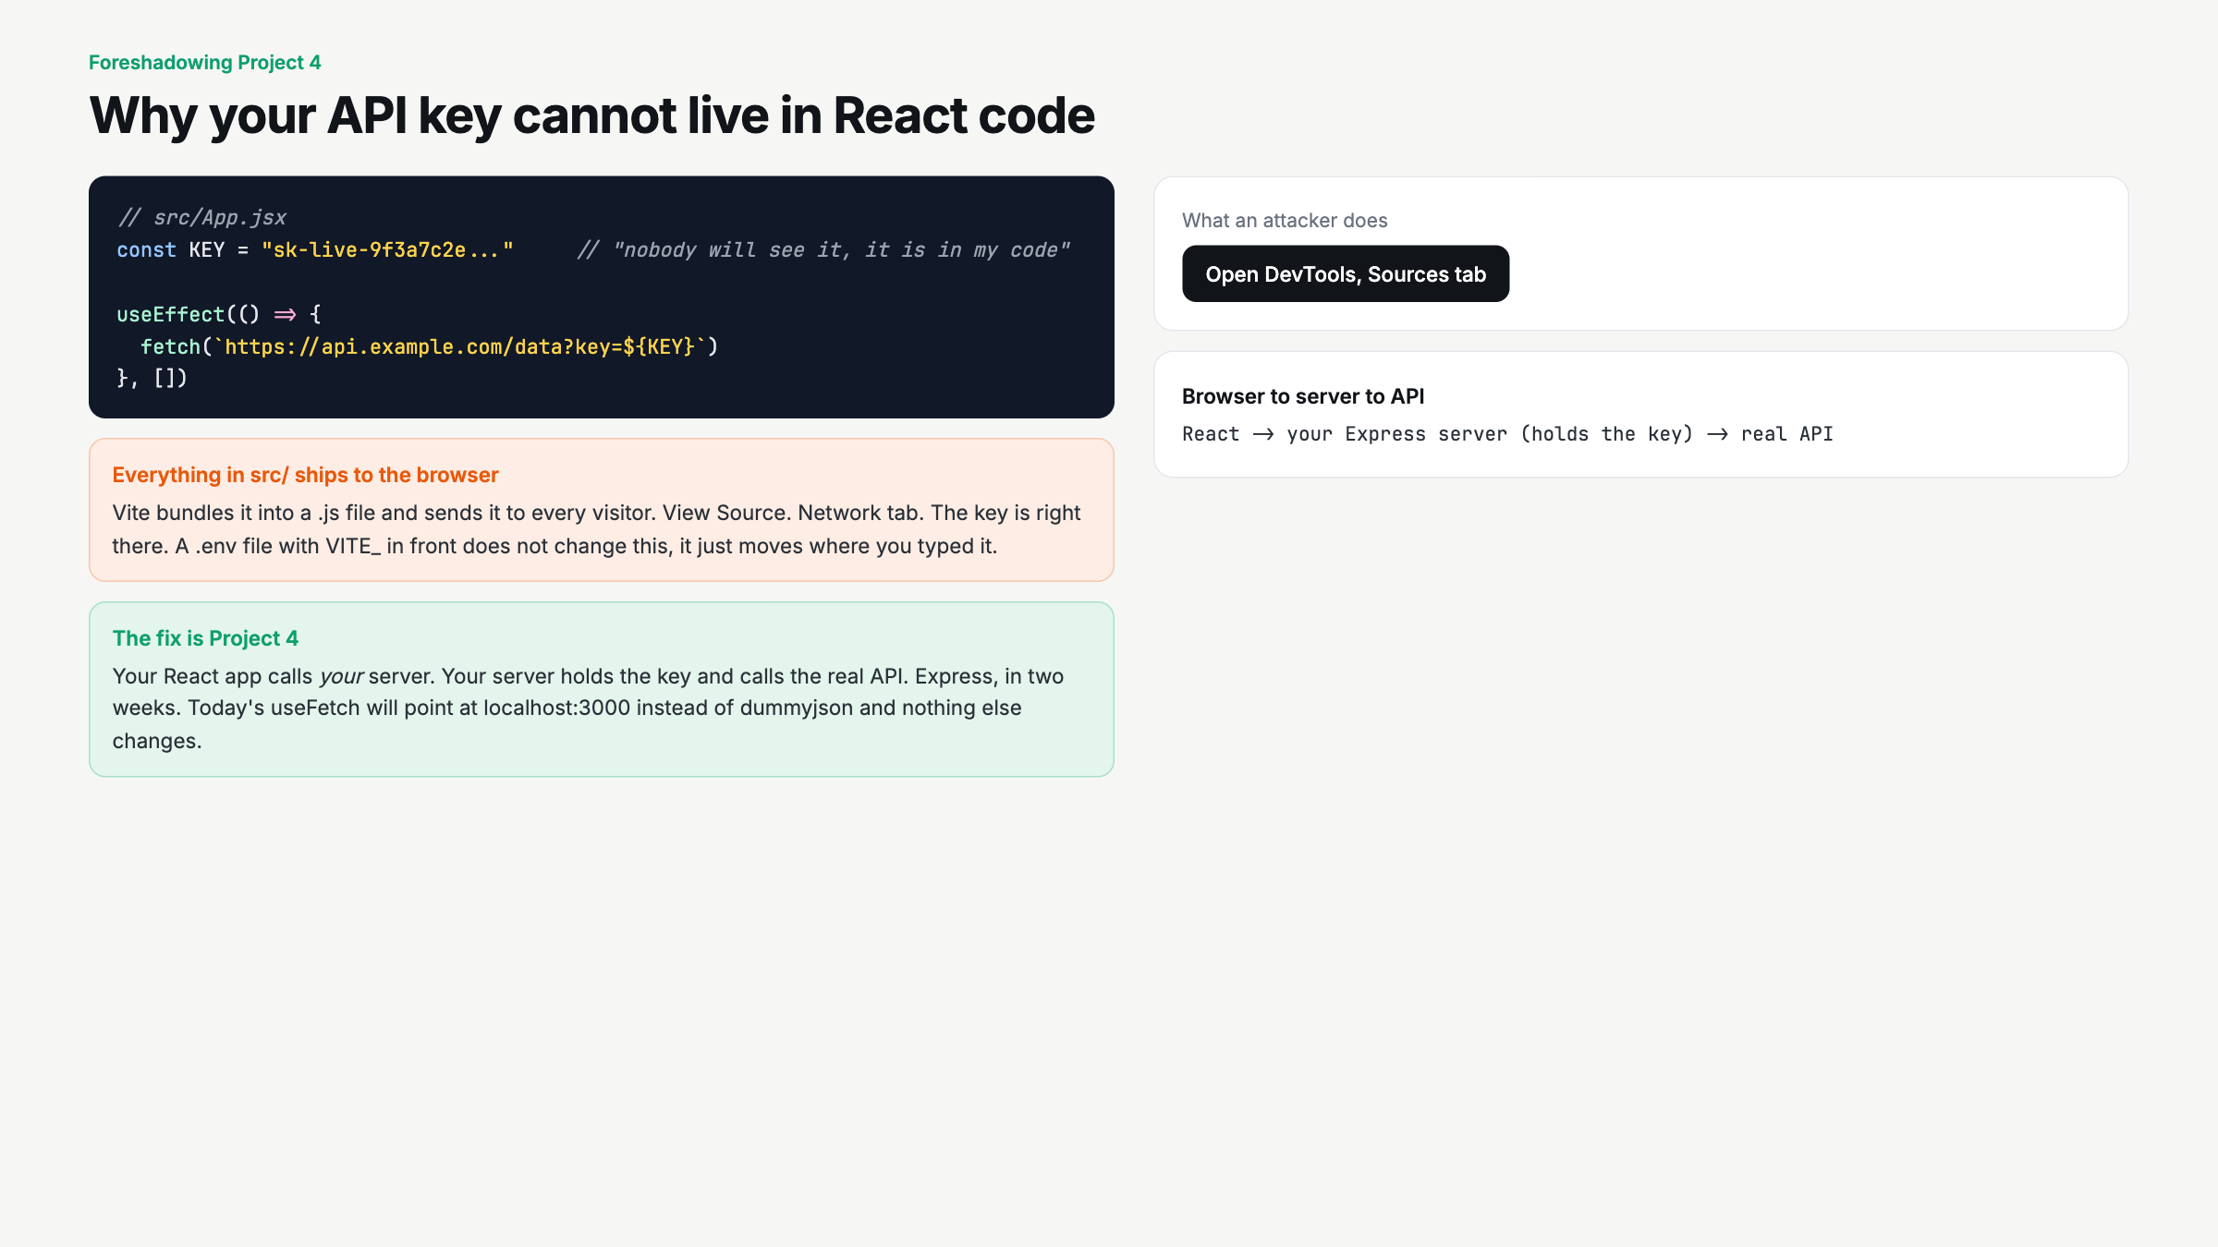
Notes:
Click Open DevTools. Then actually do it live on the real app: npm run build, open dist, grep for a string. Thirty seconds. This is why Project 4 exists.

Slide 10
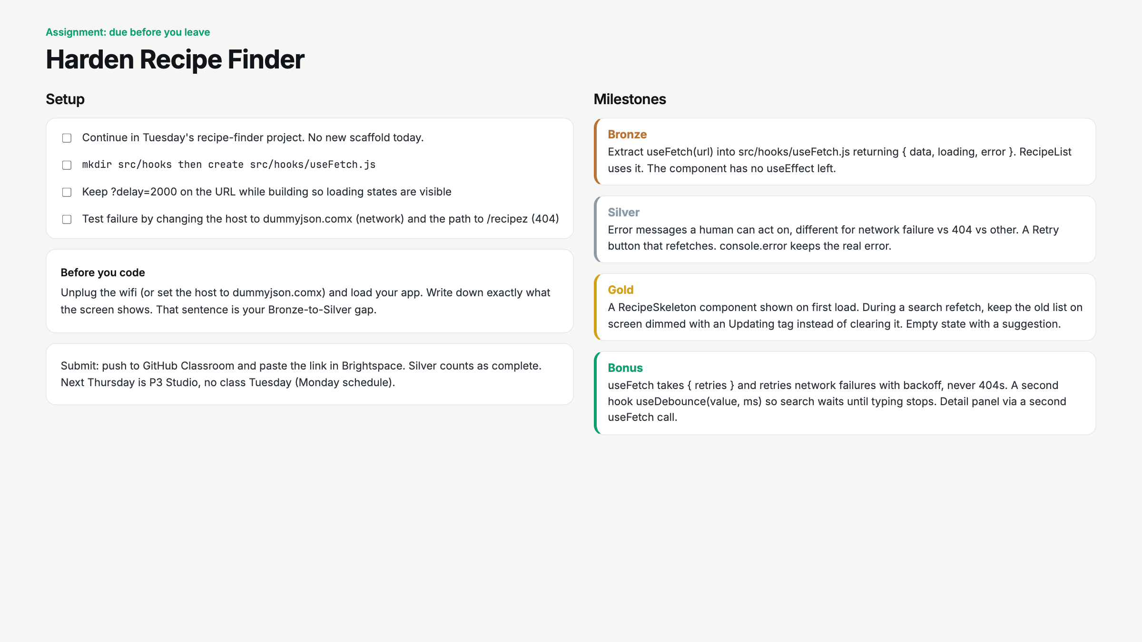
Notes:
Wifi-off test first, on paper. Start a 25 minute timer. Circulate for useEffect left inside components after extraction, and for retrying 404s.

Slide 11
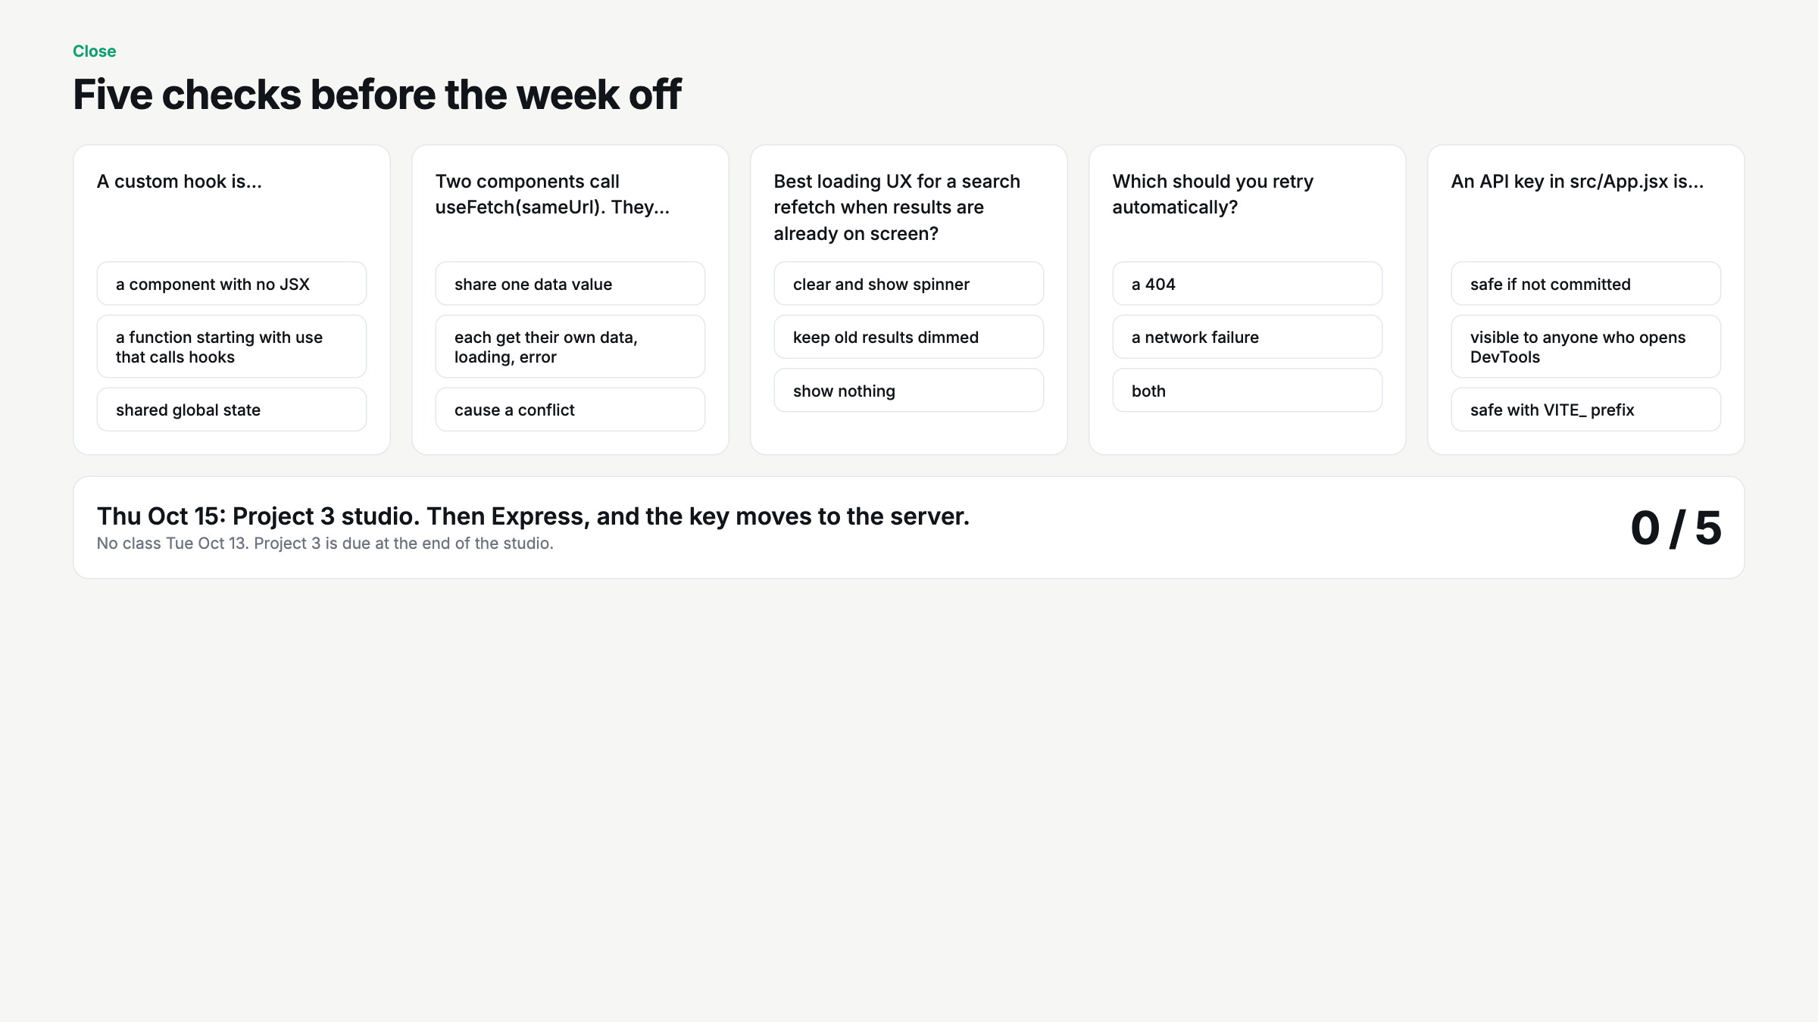
Notes:
Hands up per question. Q5 is the setup for Express. Remind: no class Tuesday, P3 Studio Thursday.

